Slide 1
Today’s Focus: “Cask of Amontillado”
Vocabulary
Irony
Reading notes /helps

Slide 2
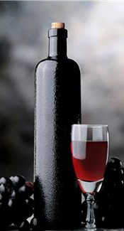
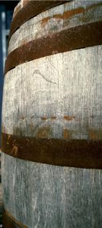

Slide 3
Please have you warm-up notebook out to complete activities and take notes

Slide 4
“Cask of Amontillado”
Quick Activity: Copy each word and rate it 1-4. 1=No clue. 2=I’ve seen it. 3=Think I know it. 4=I use the word.
precluded afflicted termination
retribution explicit subsided
accosted recoiling

Slide 5
I will provide examples, and you will guess the definition. I’ll call on your cards for guesses.

Slide 6
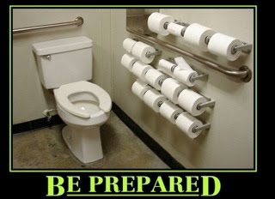
We precluded any possible emergency in the restroom

Slide 7
Preclude: to prevent from happening/ make impossible

Slide 8
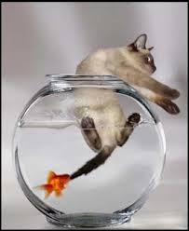
The Fish gets his retribution at last

Slide 9
Retribution: revenge

Slide 10
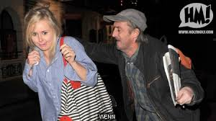
The beggar accosted me for money

Slide 11
Accost: approach and address boldly and often aggressively.

Slide 12
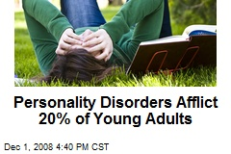

Slide 13
She is afflicted with glowing redness on her arm.

Slide 14
Afflict: To cause pain or harm

Slide 16
Explicit: Stated clearly and in detail, leaving no room for confusion

Slide 17
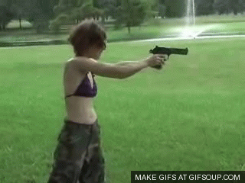
And the gun recoiled...

Slide 18
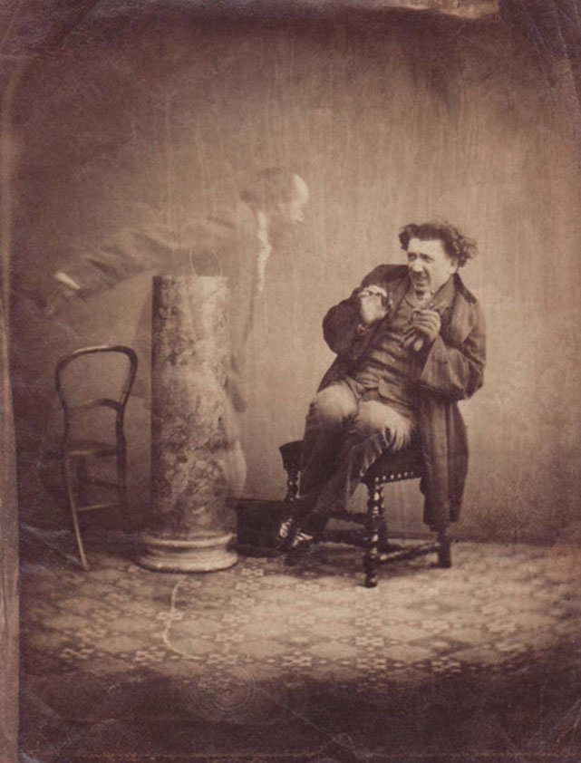
A man recoiling from a “Ghost” proves to be a double exposed photo.

Slide 19
Recoil: to suddenly spring back, often in horror or disgust

Slide 20
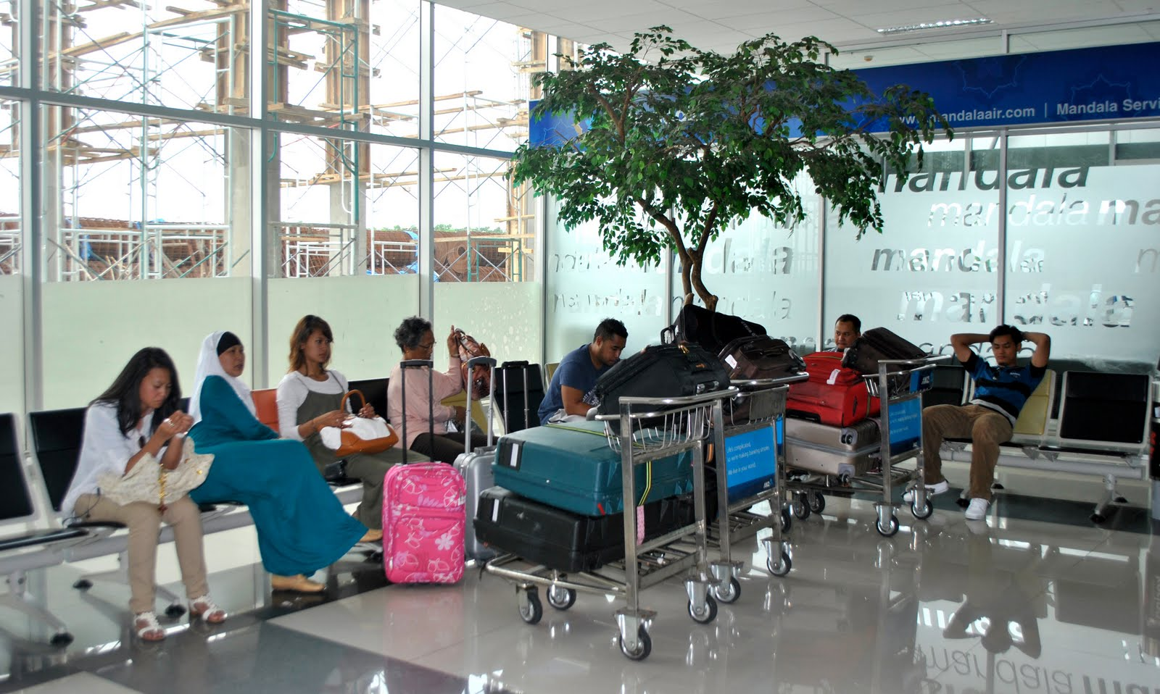
In the terminal, we awaited the termination of our journey

Slide 21
Terminal: predicted to lead to death

Slide 22
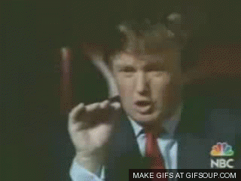
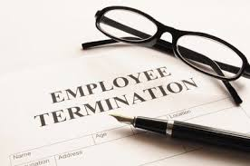
Donald Trump terminated my employment.

Slide 23
Termination: To end or fire

Slide 24
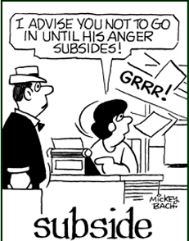

Slide 25
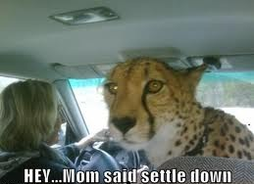
The driver was distracted until the rowdy kids subsided.

Slide 26
Class work: Do Now!
Write a paragraph using at least 3 of the vocabulary words. TOPIC: your own life experiences (maybe an obstacle?). UNDERLINE THE WORDS.

Slide 27
“Cask of Amontillado”
Quick activity : With a partner I WILL ASSIGN, come up with 2 sarcastic “compliments” to give each other (don’t be seriously mean! & be ready to share).

Slide 28
IRONY
Verbal: a writer or speaker says one thing but really means something completely different

Slide 29
IRONY
Situational: when there is a contrast between what would seem appropriate and what really happens, or when what we expect to happen is in fact quite contradictory to what really does take place

Slide 30
IRONY
Dramatic: when the audience or the reader knows something important that a character in a play or story does not know

Slide 31
IRONY
Dramatic: when the audience or the reader knows something important that a character in a play or story does not know

Slide 32
ALLUSION: CARNIVALE
Jot notes on the video -
“Catholic History of Mardi Gras, Fat Tuesday, Lent, and Ash Wednesday”

Slide 33
Jot notes on the video
“Catholic History of Mardi Gras, Fat Tuesday, Lent, and Ash Wednesday”

Slide 34
Jot notes on the video
“Carnival of Venice - Italy”

Slide 35
Jot notes on the video
“Carnival of Venice - Italy”

Slide 36
Allusion: Catacombs
Jot notes on the video -
“Inside the Catacombs of Paris”

Slide 37
Jot notes on the video
“Inside the Catacombs of Paris”

Slide 38
Situational Irony
Stop video at 2:05

Slide 40
Verbal Irony
(and situational irony)

Slide 42
Dramatic Irony
(and situational irony)

