Slide 1
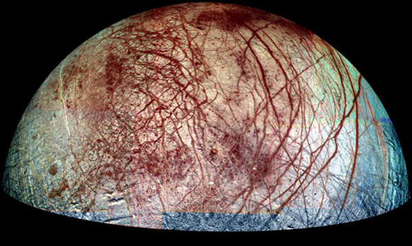
Colon Example
Thorton’s ideas about life on other planets is actually well-founded: “Water is the life sustaining element, and there are not just a few but several planets and moons that contain what Earth itself is fundamentally composed of.”

Slide 2
Introducing the Speaker Examples From Your Work!
Byusse goes on to say that “sleep quality disturbances are frequently reported in essentially all psychiatric disorders, including depression, schizophrenia, anxiety disorders, and psychoactive substance abuse disorders” (Buysse 2).
According to Daniel J. Byusse, a professor, researcher and medical doctor at the University-Pittsburgh Medical Center, “factors relating to anxiety and stress are one of the most important concomitants [results of] sleep complaints in the general population” (Buysse 1).

Slide 3
Other ways to say “says”
Rather than using “according to” or “says” to many times, remember that variety in writing is key to good mechanics and style.
I’ve included a list of 200 different ways you can say “says”. If you are unfamiliar with a word/phrase, first look it up before using it.

Slide 4
Ending your CD
Your concrete detail, that is, information you’ve researched and included to support your topic, should always be given source credit at the end of the sentence, in parenthesis.
According to the Genetic Literacy Project, “1 in 10 individuals will be born with the gene DC459” (Powledge 1).
Include the last name of the author if available, the page number (usually “1” on web-based articles), and if no name is available, the first few logical words of the title of the website page, placed in quotation marks (found at the top of your browser).
Here, if the author was not available, I would include use (“Left-Handededness” 1), so as long as none of my other web page titles began with the same phrase.

Slide 5
Commentary
Commentary follows your concrete details, and does one of five things:
Offers an opinion
Offers an interpretation
Offers insight
Contains a personal reaction
Offers evaluation

Slide 6
Commentary
Your commentary should be thorough, assuring that your ideas are fully developed in your writing.
I would suggest 2-3 sentences of
thoughtful commentary following
each concrete detail you’ve
included.

Slide 7
Offering an Opinion
Normally, this would be your “I think” statement, which many of you are inclined to write.
Instead of writing “I think”, be assertive.
“What this means is that…”
“The idea that [given idea] is brilliant, because…”
Without a doubt, what he meant was…

Slide 8
Offering Interpretation
Normally, this would be your “This shows” statement, which many of you are inclined to write.
Instead of writing “This shows”, be creative
This provides insight into whether or not [your argument] in that . . .
This allows us to see that not only can graffiti be beautiful, but it truly is the stroke of a genius.

Slide 9
Offering Insight
This helps readers see more deeply into an issue, and can be extremely beneficial in your rebuttal paragraph
What most people do not see on the surface is that . . . [insert idea] but what Blockenshore points out is that . . .

Slide 10
Contain a Personal Reaction
Here, you react, often showing some sense of emotion. How does the information make you feel? Why?
Brown’s statement is indeed startling. However, such a bold statement is done with a purpose, and helps scientists and the common man alike question [such and such idea]

Slide 11
Offer Evaluation
This brings clues together (like those that you’ve been researching!) to come to a logical conclusion (thereby, also building your logos!)
Incidents like these are not coincidental, and further help point to a [insert your opinion/ topic here]

Slide 12
Repeat…
For your bodies, you must include at least two concrete details per paragraph, and your body paragraphs must be at least 12 sentences long.
If your paragraph is not enough sentences long, either add additional commentary to an already existing concrete detail, or add another, relative, supporting concrete detail.

Slide 13
Concluding Sentence
The concluding sentence of each body paragraph simply summarizes your main ideas and helps transition into the next sentence by reminding readers of your original thesis idea.
Therefore, since we can see that [point A, point B, point C], it comes as no surprise that [reminder of thesis statement].

Slide 14
Homework
Be working on your rough draft of all paragraphs (due next Tuesday).
PRINT the following documents from Adobe!! (So you have them!) and put them in an organized folder, by next class. You must do this on your own time, using the lab, library, or my class THE FIRST 15 MINUTES after school only.
Official outline
Model Paper (about 8 hours of sleep)
Commentary Assignment (12 sentences on 6 details from your outlines, “Task 2” , and turned in last class)
Typed intro and body

