Slide 1
Verbal Discussion Warm-up
Please have out your electronic document on “The Scarlet Ibis” analysis.
Review the first question, about pride.
Please be ready to share an example from your life, or the life of someone else, in which pride was either a beautiful thing or a destructive thing.
We will discuss pride, and then continue to discuss “The Scarlet Ibis” in analytical detail.

Slide 2
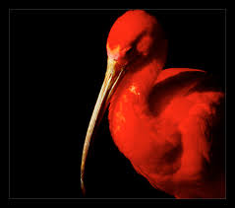
“The Scarlet Ibis”: Need To Knows (take notes in handout lines)

Slide 3
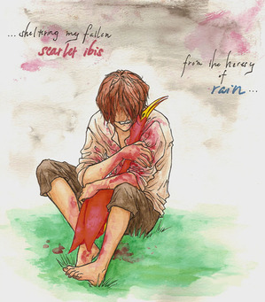
Characters—super significant!

Slide 4
Brother
Personality: Driven
Positively driven by love, family, friendship, intelligence, physical strength and endurance, and connections with nature
Negatively driven by guilt, shame, and insecurity
Discussion: Given that Brother is 13, is his guilt, shame, and insecurity justified?
Discussion: Even though he believes, in the end, he is at fault, would you blame Brother for Doodle’s death?

Slide 5
Brother’s Current Status
Wrapped up in memory
Brother is fixated on the death of Doodle, and that memory clouds and impacts his thinking even now.
Discussion: What types of words (diction) and imagery (sensory/ vivid details) are provided that show that Brother could still be depressed? What repeating images and ideas keep coming up?

Slide 6
Brother’s Current Status
Without individual identity
Brother narrates this story, and yet he is not even given a name.
We don’t know how old Brother is now, because he is so wrapped up in the past.
Discussion: What details in the story allow us to know that Brother is consumed with living in the past?

Slide 7
William “Doodle” Armstrong
Intelligence: Genius
Brother recognizes, not only, that Doodle is “all there” but that he talks excessively, so much, that others sometimes can’t understand him.
Doodles lies are awfully advanced for a little six-year-old
Activity: Draw this, one of Doodle’s lies, using Google images to help you understand the flower type and vortex, if needed:
When Peter was ready to go to sleep, the peacock spread his magnificent tail, enfolding the boy gently like a closing go-to-sleep flower, burying him in the gloriously iridescent, rustling vortex (3.21).

Slide 8
William “Doodle” Armstrong
How many of you missed how deep Doodle is?
We, as readers, focused more on Doodle’s physical description.
Brother goes to lengths to make sure that Doodle’s classmates will not make this same mistake.

Slide 9
Story Themes

Slide 10
Memory and the Past
Consider how Brother’s past memory shapes who he is.
Create a one-sentence statement about something we can learn.
Beginners:
Distant memories can still . . .
When the past hurts, . . .
Memory is powerful, because . . .
Memory is helpful, because . . .

Slide 11
Pride-Discussion
Brother has pride, this is certain.
How specifically is pride helpful for Brother? How is it harmful?

Slide 12
Love-Discussion
Brother loves Doodle then, and he loves him now.
Does Brother use the word "love" in the story? If so, where? If not, how can love still be a theme?
How is the writing of this story itself an act of love for Brother? What does he have to give up as a result?

Slide 13
Reader Impact

Slide 14
Seeing Red
How did it make you feel seeing this whole presentation in red?
The story itself uses red (through imagery and synonyms of the word red) several times.
How does this help us to understand the character of Brother better?

Slide 15
Misjudgment
What did you initially believe to be true about Doodle?
Whom did you have more pity on?
How did the author allow you to miss subtle clues, like the fact that Doodle was a genius, or that he was developing into his own personality?

Slide 16
Empathetic Sadness
This story holds a deep emotional impact.
How does the way the sentences are framed impact the reader?
How do the choice of words impact the reader—in ways we don’t initially realize?
How does the setting become familiar to us as young people?

Slide 17
Empathetic Sadness
Why do you think Brother wanted us to actually experience the same emotions he did?
Is there any sense of healing in the story?

Slide 18
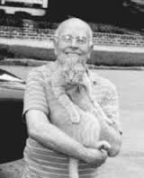
James Hurst and the War

