Slide 1
Q&A Warm-up
Please write your three major questions you have about the writing process. Make sure that they are also questions that will benefit other students in this class, and about the writing process (not about past work past due). If you don’t have questions, work on your rough draft.

Slide 2
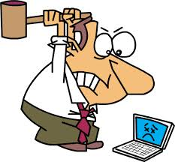
Rebuttal Paragraph
Actually, this follows your normal academic paragraph structure (TS, CX, CD, CM, CS).
TS=list the opposing side. (You may or may not choose to use a quotation to exemplify the opposing side’s beliefs; I did).

Slide 3
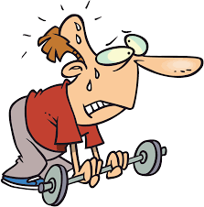
Rebuttal Paragraph
The remaining paragraph you prove the opposing side to be weak through CX, CD, CM, CS.
(And initially explain a little more about the opposing side.)
Then, your concluding sentences summarizes your ideas, reminds readers that the opposing side is weak, and brings you back to your overall thesis idea.

Slide 4
The Conclusion
The last paragraph of your essay should be well-written, not hastily thrown together.
It’s design is to remind readers of your most important points, and leave readers satisfied, fully convinced that they have no choice but to take your side.

Slide 5
The Conclusion: Structure
Begin with a rephrased thesis.
My example: Because the argument that people can survive well on less sleep is faulty, it is crucial for adults to get at least hours of sleep a night, optimizing their mental health, energy levels, and overall well-being.
I used a connection to the rebuttal paragraph, stated my opinion, and briefly listed my reasons why.

Slide 6
The Conclusion: Structure
Your next few sentences should be a summary of your main ideas, expanding on the list.
My example: Without adequate sleep, our psychological status begins to break down, rendering us more susceptible to stress and depression. Additionally—and ironically—we begin to lose our ability to be productive as our energy levels wane and chemical workings, including how fast we turn food over into energy, how fast we get information to our brain, and even how well our hearts work, begins to dissipate.

Slide 7
The Conclusion: Structure
Next, you’ll come up with a call to action, or something you want readers to specifically to do as a result of persuading them to believe your side.
Basic formula:
Talk about the seriousness/ importance of your topic + ask/tell the reader to act (trying to avoid the generic “you” if possible)
Example: For these reasons, we should make every effort to not prioritize our temptingly fun hobbies and pridefully-based busy schedules, but to simplify our lives to make time for one of the most important aspects of life: sleep. This means turning our electronics off a few hours before bedtime, so that they do not interfere with our circadian rhythm, minimizing wasted time if our schedules are indeed busy, purchasing ear plugs if we are distracted by noise, exercising enough to be tired, not wired, and doing all things possible to achieve those eight precious hours.

Slide 8
Closure
Sometimes the call to action ends in a satisfying matter, but if it doesn’t, a cheesy, “good-night-kiss” closure is still needed.
Good words to start this off include “Therefore,” “Of course,” “There is no longer any doubt that,” “Clearly,” etc. and wrap up with a final thought. Use your best judgment to determine if your last sentence of your call to action is catchy enough, or if you need to add another closure sentence.

Slide 9
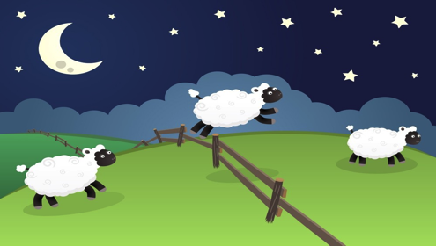
Closure
My example: Of course, we will all run into rare nights in which sleep is diminished, whether by choice or restless sleeping, but our very happiness, livelihood, and well-being are clearly dependent on our ability to rest our heads on our pillows and get our coveted Z’s. Our Z’s, indeed, are worth fighting for.

Slide 10
Works Cited
Now that you’ve worked on and learned the process for each paragraph in your essay, you must also see how to properly cite the sources you’ve used.
This is why you were to write down each website, so that this process, now, is not too difficult.
The easiest recommendation I have is to use a website called “Easy Bib,” which is linked to today’s agenda.

Slide 11
Easy Bib
First, write down the FULL url of the article/ webpage you read in the blank spaced marked “Cite Source” and then press the orange button “Cite It.”
After pressing “Cite It,” check to see that the information listed next is the correct information, and if it is, press “Continue.” If it isn’t, press “Continue” anyway, and be ready to edit.

Slide 12
Easy Bib
Check all info again, making sure that the right info is in the right boxes.
You do not need to display the URL.
When all is checked and looks okay, press “Check Citation.”
The next page warns you that your bibliography will expire in three days and to create an account to save it. This costs money, so avoid it.
To save your entry, click “Copy and Paste Citation” and then copy and paste into a Google Doc (best) or Word document (that you email to yourself, so as not to lose it accidently on a school computer).
Make sure your working Works Cited page is saved online, so that you can access it as you continue to add to it.

Slide 13
Works Cited
Last but not least, a special format is needed for your Works Cited page.

Slide 14
Hanging Indent and Alphebetziaing
After copying and pasting your EasyBib created Works Cited entry, simply click on the end of the first line, press enter, and then press “tab.” It’s that easy!
Finally, remember that there are no extra spaces between each entry (just perfectly double spaced), AND
All entries should be alphabetized correctly, regardless of if you have an author’s last name available or not. Make sure they are.

Slide 15
Random Spot Check
I will be checking Works Cited entries at random when I grade your final papers.
Make sure that your sources ARE credible, so that you do not lose points on this portion.
Make sure that ALL outside info you’ve used in your essay (whether quoted or paraphrased) receives a parenthetical citation within your essay that matches the citation in the Works Cited page.
If you fail to do this, it is considered plagiarism.

